Slide 1
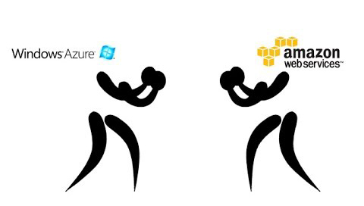
Building Scalable Serverless Apps in the Cloud: AWS or Azure ?

Slide 2
Hector Villafuerte
Business Intelligence Architect at Starwood Property Trust
Microsoft Certified Technology Specialist, SQL, Dynamics CRM - MCTS
Works with SQL Server, Excel, Power BI, SSIS, SSAS, SSRS, SharePoint, Dynamics CRM and Azure PAAS.
Microsoft Certified Professional Developer – MCPD
Full-stack .NET Developer and Web Applications Architect.
Reach me at:
Twitter - @optimumclick
http://www.hectorv.com
optimumclick@gmail.com

Slide 3
Agenda
Building Scalable Serverless Apps in the Cloud: AWS or Azure ?
Serverless Architecture
AWS and Azure Comparison: Functions
AWS and Azure Comparison: NoSQL databases.
Visual Studio Tooling
AWS: Serverless App Demo: Implementation of Lambda and DynamoDB
Azure Serverless App Demo: Implementation of Azure Functions and CosmosDB
Conclusions

Slide 4
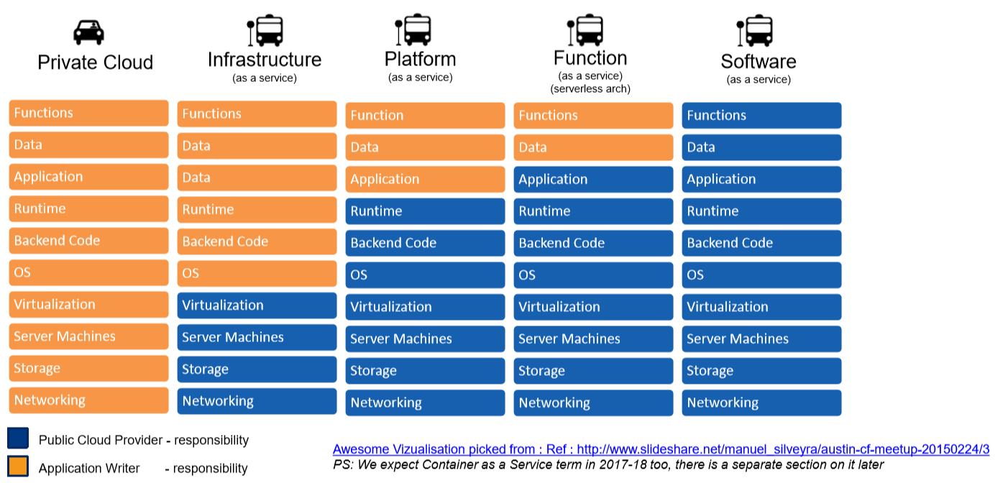
IaaS – PaaS, FaaS, SaaS

Slide 5
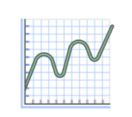
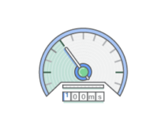
Benefits of Serverless Computing
No Servers to Manage
Continuous Scaling
Dynamic allocation of resources
Avoid overallocation of resources
Never Pay for Idle: pay-per-usage

Slide 6
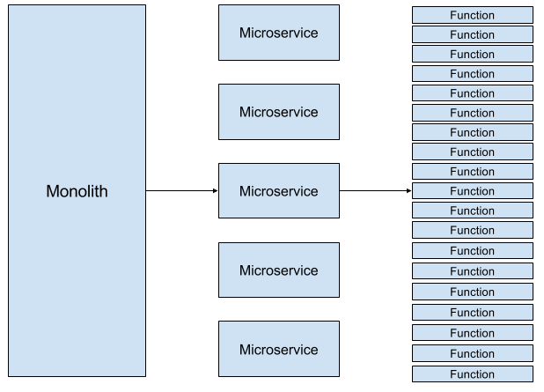
Microservices Architecture
Serverless Function
We’ve gone from monoliths to microservices to functions
Microservices
Smaller-grained services
Specified Functions
Defined Capabilities
Event handler
Serverless back ends
Data processing
“Serverless function” or more accurately “Functions as a Service”
Principles of FaaS:
Complete abstraction of servers away from the developer
Billing based on consumption and executions, not server instance sizes
Services that are event-driven and instantaneously scalable

Slide 7
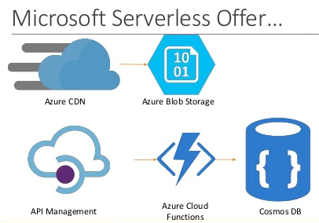
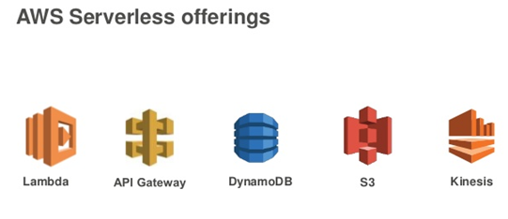
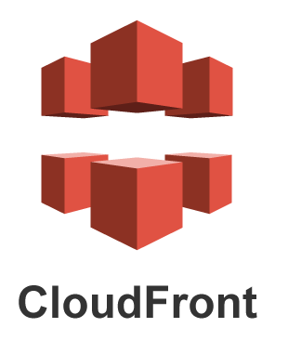
Comparable Serverless offerings: Azure vs AWS
Backend as a Service or "BaaS“ and Function as a Service or "FaaS"
..and many more.

Slide 8
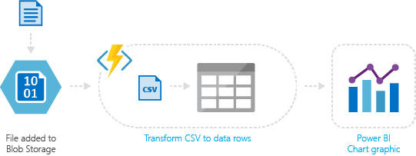
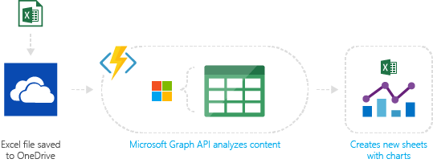
AWS and Azure Use Cases
Azure service event processing
Real-time stream processing
SaaS event processing

Slide 9
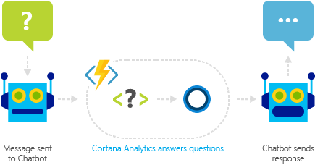
…more AWS and Azure Use Cases
Timer-based processing
Real-time bot messaging
Serverless web application architectures
Serverless mobile back ends

Slide 10
AWS vs Azure Function Price Comparison
 | AWS Lambda | Azure Functions
Free Tier | 1,000,000 free requests per month Up to 3.2 million seconds of compute time per month | 1 million executions per month 400,000 GB-s per of Execution Time per month.
 | $0.00001667 FOR EVERY GB-SECOND $0.20 PER 1M REQUESTS | Execution Time: $0.000016/GB-s Total Executions: $0.20 per million executions.
Prices as of Jan 2018
https://azure.microsoft.com/en-us/pricing/details/functions/
https://aws.amazon.com/lambda/pricing/

Slide 11
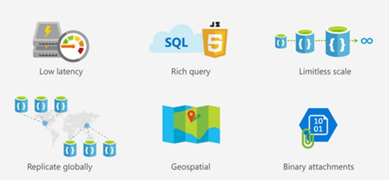
NoSQL Databases
Azure DocumentDB
DynamoDB
Azure Tables
Cassandra
HBase
Redshift
Neo4j
Amazon Neptune
JanusGraph/Titan
OrientDB
DocumentDB
DynamoDB
MongoDB
A NoSQL (originally referring to "non SQL" or "non relational") database provides a mechanism for storage and retrieval of data that is modeled in means other than the tabular relations used in relational databases.

Slide 12
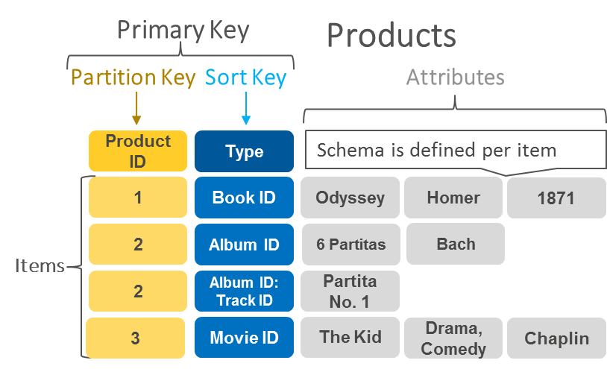
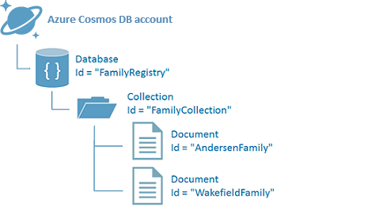
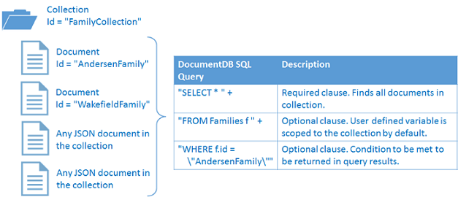
DynamoDB Tables
DynamoDB
DocumentDB
Amazon DynamoDB is a fully managed proprietary NoSQL database service that is offered by Amazon.com since 2012.
Azure Cosmos DB is Microsoft’s proprietary globally-distributed, multi-model database service "for managing data at planet-scale" launched in May 2017. It builds upon and extends the earlier Azure DocumentDB, which was released in 2014.
DocumentDB Collections
The primary key uniquely identifies each item in a table. The primary key can be simple (partition key) or composite (partition key and sort key)

Slide 13
Terminology and concepts
Generic terminology | SQL | DynamoDB | Azure Cosmos DB
Container | User Schema | Region | Collection
Entity | Table | Table | Document Type
Record | Record | Item | Document
Attribute | Column | Attribute | Field
Primary Key | Primary Key | Hash (& range) | id
Index | Index | Index | Index
Partition | Partition | Partition | Partition
View | View | Global Secondary Index | n/a
Object | n/a | Map | Object
Array | Array | List | Array

Slide 14
AWS and Azure NoSQL database price Comparison
 | Amazon DynamoDB | Azure Cosmos DB
Free Tier | 25 GB of Storage, 25 Units of Read Capacity and 25 Units of Write Capacity – enough to handle up to 200M requests per month | Free for 12 months.
 | Provisioned Throughput (200M Writes) $0.47/month Provisioned Throughput (5.2M Read) $0.09/month | Reserved Request Units (RU)/second (400 RUs minimum) $0.008/hour => $5.86/month
Data Storage (per GB) | $0.25 | $0.25
Prices as of Jan 2018
https://azure.microsoft.com/en-us/pricing/details/cosmos-db/
https://aws.amazon.com/dynamodb/pricing/

Slide 15
Recap
Serverless Architecture
Use cases
Serverless Functions: AWS Lambda and Azure Functions
No SQL databases: AWS DynamoDB and Azure Document DB.

Slide 16
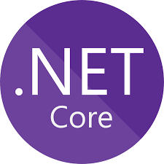
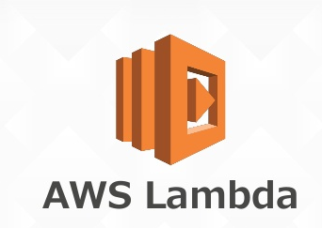
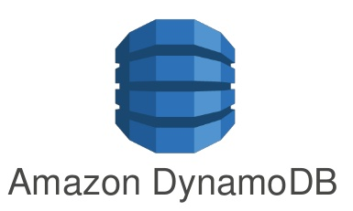
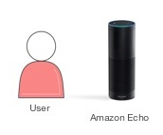
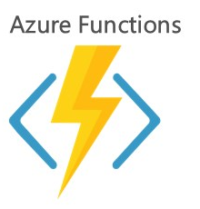
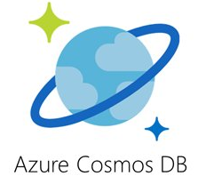
Alexa Skill with AWS and Azure

Slide 17
Getting started with AWS
Sign up for an AWS Account (Free, requires credit card):
https://aws.amazon.com/account/

Slide 18
Demo: Alexa Skill with AWS lambda
Create a lambda function in AWS

Slide 19
Getting started with Alexa Service
Sign up for an Amazon Developer Account (Free):
https://developer.amazon.com

Slide 21
Demo: Alexa Skill with AWS lambda

Slide 22
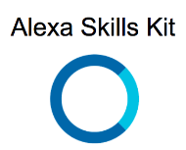
Alexa Skill with AWS lambda and DynamoDB

Slide 23
Provides Credential to access services
Roles that can be assumed by applications and services
Policies that can define minimal permissions

Slide 24
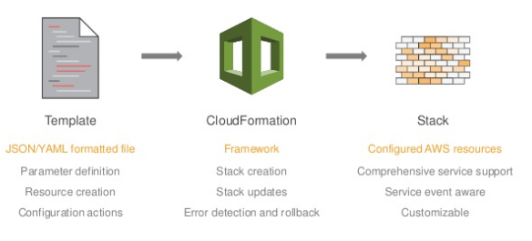
AWS: CloudFormation
Declare AWS architecture in template file
Templates can be parameterized
Allows creating and deleting AWS architecture as a unit.
Instantiated template is called a Stack

Slide 25
AWS Development tools for .NET
Visual Studio 2017
https://www.visualstudio.com/vs/
NET Core 2.1.3 SDK
https://www.microsoft.com/net/download/windows
AWS Toolkit for Visual Studio 2017 - Released on June 2017
Added Support to .NET Core 2.0 on latest version
https://aws.amazon.com/visualstudio/ or use Visual Studio Gallery.
The AWS Toolkit for Visual Studio conveniently includes the AWS SDK for .NET.

Slide 26
Demo: Alexa Skill with AWS lambda and DynamoDB
Developer Experience

Slide 27
Alexa Skill with Azure Functions and DocumentDB

Slide 28
Getting started with Azure
Create an Azure Account
Azure Functions Tools is included in the Azure development workload of Visual Studio 2017 version 15.4, or a later version.
https://www.visualstudio.com/vs/

Slide 29
Demo: Alexa Skill with Azure Functions and DocumentDB

Slide 30
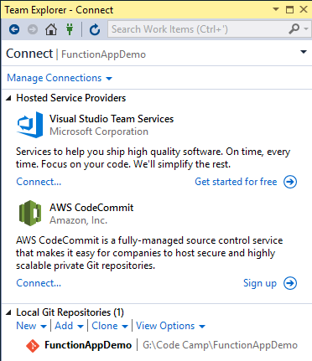
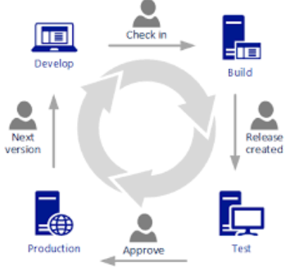
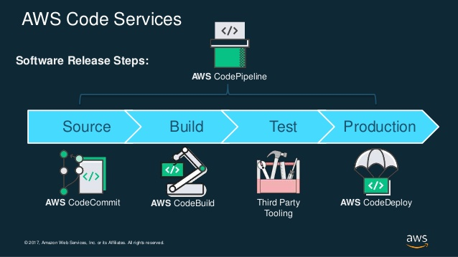
Continuous Integration/Continuous Deployment (CI/CD)
Visual Studio Team Services

Slide 31
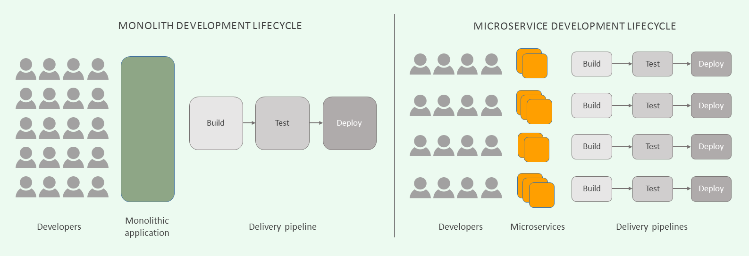
Cost is reduced and Complexity is increased with Serverless

Slide 32
Serverless Computing
Fits for Serverless Computing?
Fit | Not a Fit
Net new | Legacy
Value on Scaling | No value on scaling
Service oriented | Traditional
There are Limitations and The Tradeoffs/Drawbacks of Serverless
Married to the public cloud
Not portable to other platforms
Open standards are needed
Security, governance, and other services are not portable either.
How long it can functions run: 5 minutes limit.
Cold Starts

Slide 33
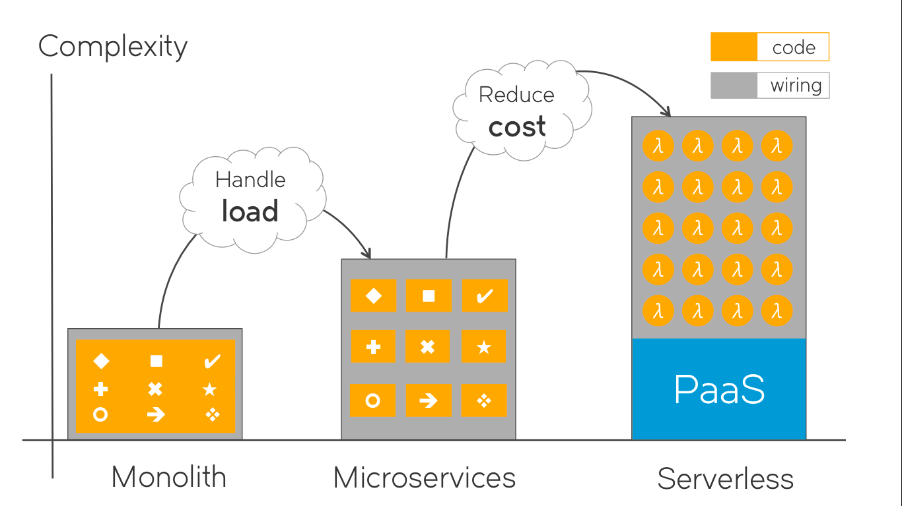
Cost of operation, usage and scale is reduced and Architectural Complexity is Increased with Serverless

Slide 34
Advantages of Serverless Computing
Simplifies deployment and packaging and eliminates the need for system administration.
Works with agile development and enables the developers to concentrate on code and deliver quickly.
Lesser cost to scale – the developers need not implement code to scale and the administrators need not upgrade the servers that are existing or add any additional servers.
Smaller development and operational costs.
Decreased time to market and faster software release.

Slide 35
Recap
Alexa Skill implementation Demo.
AWS: Serverless App Demo: Implementation of Lambda and DynamoDB
Azure Serverless App Demo: Implementation of Azure Functions and CosmosDB

Slide 36
Conclusions
AWS Lambda allows to deploy an Existing ASP.NET Core Web API to AWS Lambda, with APIGatewayProxy integration.
Local Debugging
AWS Lambda does not have any facilities to run and debug functions locally.
SAM Local is still in Beta. https://github.com/awslabs/aws-sam-local
Azure Functions host has an on premise implementation and can provide a full local development environment.
Azure Cosmos DB Emulator
Remote Debugging
Azure Functions allow to Attach Debugger.
Deployment Facilities in AWS
C# code can now be used to leverage a much wider range of platforms and ecosystems.

Slide 37
Resources:
AWS Toolkit for Visual Studio Documentation
https://aws.amazon.com/documentation/aws-toolkit-visual-studio/
Azure Functions Documentation
https://docs.microsoft.com/en-us/azure/azure-functions/
Azure Functions developers guide
https://docs.microsoft.com/en-us/azure/azure-functions/functions-reference
Hector Villafuerte
Blog: www.hectorv.com
E-mail: optimumclick@gmail.com
Questions?

